Slide 1


EXPERIENCED &
EXPERT TEAM FOR
YOUR
HIRING
BRILLBRAINS HIRING SOLUTIONS
RECRUITMENT PARTNER TO THE JEWELLERY INDUSTRY
jobs@brillbrainsconsultants.com
90934 00222
Mumbai, India
Notes:
Open with the brand promise: an experienced, expert team that runs your hiring end to end.

Slide 2

ABOUT US
WHO WE ARE
The premium recruitment brand of BrillBrains Consultants Pvt. Ltd. — built for the jewellery industry.
OUR APPROACH
We don't send resumes. We run the hiring system: role definition, job descriptions, interview design and professional documentation.
RIGHT TALENT. REAL IMPACT.
Notes:
We are the recruitment arm of BrillBrains Consultants. We deliver a hiring system, not a resume feed.

Slide 3





MISSION & VISION
MISSION
To become the leading hiring partner for jewellery brands globally.
VISION
To streamline jewellery recruitment into one clear, documented and repeatable process.
Notes:
Mission: the leading hiring partner for jewellery brands globally. Vision: streamline how the industry hires.

Slide 4




OUR STRENGTH
16+
YEARS IN JEWELLERY
1000+
IN-HOUSE DATABASE
30
DAY AVERAGE TURNAROUND
15+
CLIENTS SERVED
PROCESS-DRIVEN. TRAINED TEAM. STRATEGIC APPROACH.
Notes:
Sixteen years in jewellery, an in-house database, a trained team, and a thirty-day turnaround.

Slide 5

SECTION ONE
SERVICES THAT
WE OFFER
Notes:
Move into the service line-up.

Slide 6



THREE TRACKS OF HIRING
LEADERSHIP HIRING
WHITE COLLAR HIRING
BLUE COLLAR HIRING
Top management and functional heads, mapped and approached discreetly.
Design, retail, finance, compliance and operations roles across the business.
Karigars, workshop and factory-floor teams, hired at volume and at pace.
Notes:
Three hiring tracks: leadership, white collar, blue collar.

Slide 7
ENGAGEMENT FEES
LEADERSHIP
10% of CTC
WHITE COLLAR
8.33% of CTC
₹
BLUE COLLAR
8.33% of CTC
Billed on joining. Replacement guarantee included in every mandate.
Notes:
Fees are a clean percentage of CTC — ten percent for leadership, 8.33 for the other two tracks.

Slide 8







FEW OF OUR CLIENTELE
Notes:
A cross-section of listed firms, manufacturers and regional retail houses.

Slide 9
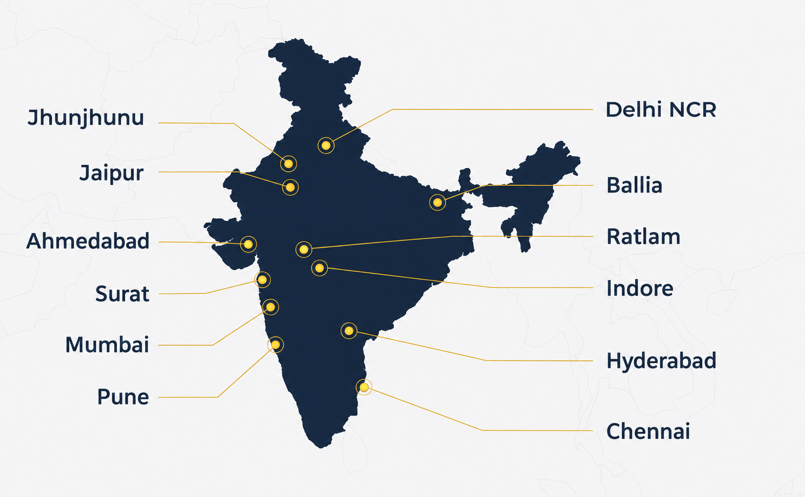
GEOGRAPHIES WE HAVE SERVED
15
CITIES ACROSS INDIA
Metro hubs, manufacturing clusters and regional retail markets.
Notes:
Mandates delivered across fifteen cities — metros plus the manufacturing and retail belts.

Slide 10

CLIENT SNAPSHOT
LISTED JEWELLERY FIRM, MUMBAI
Company Secretary mandate — role defined, shortlist built from the in-house database, interviews designed and documented.
CLOSED IN 26 DAYS
TIMELINE
PROFILES
OUTCOME
26 DAYS
9 SHARED
OFFER ACCEPTED
Notes:
Placeholder — swap in a named client mandate: role, city, turnaround, outcome.

Slide 11
HOW WE
WORK
Notes:
Now the working process, from contract to shortlist.

Slide 12



HIRING PROCESS — SET UP
01
02
03
CONTRACT SIGNING
WHATSAPP GROUP
PLATFORM ONBOARDING
Scope, roles and fees agreed in writing before work starts.
One channel with your HR team for live updates and approvals.
Job boards and portals configured under your employer brand.
Notes:
Week one: contract, a shared WhatsApp group, and platform onboarding.

Slide 13



HIRING PROCESS — DELIVERY
04
05
06
JOB POSTING
SCREENING
PROFILE SHARING
Role defined and a written job description published across channels.
Database search, structured interviews and reference checks.
Documented shortlists shared in batches until the role is closed.
Notes:
Then the delivery loop: post, screen, share profiles, repeat until closed.

Slide 14




OUR OTHER SERVICES
BRAND CONSULTING
MANAGEMENT CONSULTING
TRAINING & DEVELOPMENT
TECH CONSULTING
Positioning & identity
Structure & operations
Teams & capability
Systems & tooling
Notes:
Beyond hiring, the wider BrillBrains consulting practice is available to clients.

Slide 15
THANK
YOU
Let's scope your first mandate — role, timeline and shortlist plan in a single call.
jobs@brillbrainsconsultants.com
+91 90934 00222
hiring.brillbrainsconsultants.com
Notes:
Close with the ask: a short call to scope the first mandate.

